Slide 1


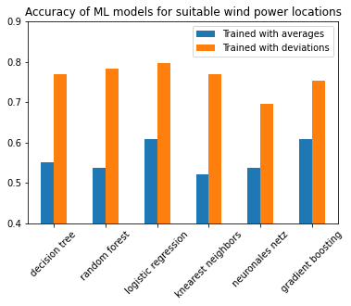


Improving model accuracy The value of domain knowledge
Notes:
Trained machine learning models
Comparison by accuracy
Accuracy = how often is a prediction by the model correct
Calculated some average numbers, fed them to the model to predict wind power locations
Some models were as good as a coin flip, pretty much totally random
Tried to improve the models with the info from the exercises, trained 60 models, got accuracy up to 75% on average, but still wanted to improve
wind is a result of changing conditions, eg mainly changing temp
So we needed a number that reflects the range of changes for temp and other input data
Widely used standard deviation does that. Higher values typically means more and greater changes in conditions
Fed std data to model, instantly got accuracy of close to 80%
Easily better than optimized models based on averages
model training just got 50 times faster
Showed us:
Even a little bit of research and knowledge about specific problem can match or even beat sophisticated machine learning
Machine learning is perfect to find patterns, but the data has to include the real world patterns, otherwise can’t reach full potential

